Slide 1
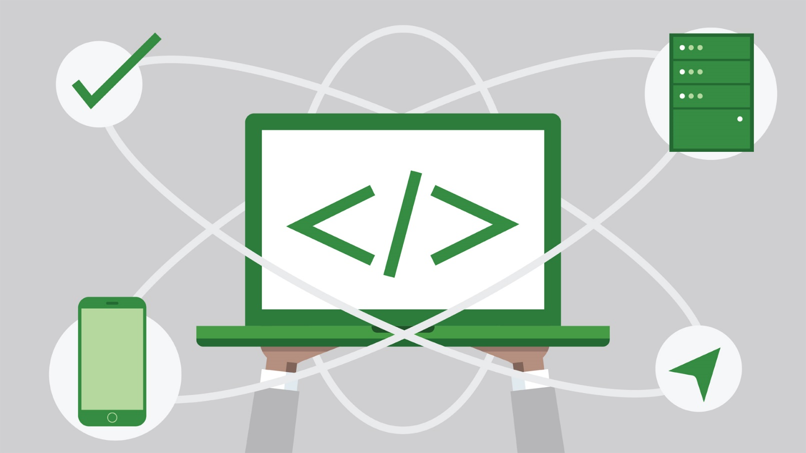
State Management
Cookies and Sessions
SoftUni Team
Technical Trainers
Software University
http://softuni.bg
Notes:
© Software University Foundation – http://softuni.org
This work is licensed under the Creative Commons Attribution-NonCommercial-ShareAlike license.
38

Slide 2
Table of Contents
HTTP Cookies
Usage and Control
Cookies in a HTTP Server
HTTP Sessions
Sessions in a HTTP Server
2
Notes:
© Software University Foundation – http://softuni.org
This work is licensed under the Creative Commons Attribution-NonCommercial-ShareAlike license.
38

Slide 3
Have a Question?
sli.do #java-web
2

Slide 4

HTTP Cookies
Usages and Control

Slide 5


What are Cookies?
A small file of plain text with no executable code
Sent by the server to the client's browser
Stored by the browser on the client's device (computer, tablet, etc.)
Hold small piece of data for a particular client and a web site
5

Slide 6

What are Cookies used for?
Session management
Logins, shopping carts, game scores, or anything else the server should remember
Personalization
User preferences, themes, and other custom settings
Tracking
Recording and analyzing user behavior
Breakfast
But that’s not what we are currently talking about
5
Notes:
38

Slide 7


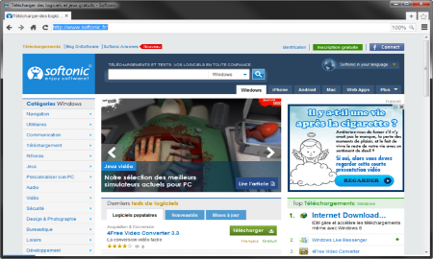



Session Management
The HTTP object is stateless
it doesn’t store information about the requests
Web Client
Web Application
GET
POST
GET
Not stored
5

Slide 8
Stateless HTTP – the Problem
The server does not know if two requests come from the same client
State management problems
Navigation through pages requires authentication each time
Information about the pages is lost between the requests
Harder personalization of functionality of pages
5

Slide 9
Stateless HTTP – the Cookie Solution
A reliable mechanism for websites to remember stateful information
to know whether the user is logged in or not
to know which account the user is logged in with
to record the user's browsing activity
to remember pieces of information previously entered into form fields (usernames, passwords, etc.)
5

Slide 10
How are Cookies Used?
The response holds the cookies to be saved within the Set-Cookie header
The request holds the specific web site cookie within the Cookie header
HTTP/1.1 200 OK
Set-Cookie: lang=en
GET www.example.bg HTTP/1.1
Cookie: lang=en
5

Slide 11
Server-Client Cookies Exchange
http://www.example.bg/
Web Client
Web Application
GET www.example.bg HTTP/1.1
HTTP/1.1 200 OK Set-Cookie: lang=en
GET www.example.bg HTTP/1.1
Cookie: lang=en
5

Slide 12
Cookie Structure
The cookie consists of Name, Value and Attributes (optional)
The attributes are key-value pairs with additional information
Attributes are not included in the requests
Attributes are used by the client to control the cookies
Name=Value
Attributes
Set-Cookie: SSID=Ap4P…GTEq; Domain=foo.com; Path=/; Expires=Wed, 13 Jan 2021 22:23:01 GMT; Secure; HttpOnly
5

Slide 13
Scope
Defined by the attributes Domain and Path
Domain – defines the website that the cookie belongs to
Path – Indicates a URL path that must exist in the requested resource before sending the Cookie header
Set-Cookie: SSID=Ap4P…GTEq; Domain=foo.com; Path=/; Expires=Wed, 13 Jan 2021 22:23:01 GMT; Secure; HttpOnly
5
Notes:
<number>

Slide 14
Lifetime
Defined by the attributes Expires and Max-Age
Expires – defines the date the browser should delete the cookie
By default the cookies are deleted after the end of the session
Max-Age – interval of seconds before the cookie is deleted
Set-Cookie: SSID=Ap4P…GTEq; Domain=foo.com; Path=/; Expires=Wed, 13 Jan 2021 22:23:01 GMT; Secure; HttpOnly
5

Slide 15
Security
Security flags do not have associated values
Security - tells the browser to use cookies only via secure/encrypted connections
HttpOnly – defines that the cookie cannot be accessed via client-side scripting languages
Set-Cookie: SSID=Ap4P…GTEq; Domain=foo.com; Path=/; Expires=Wed, 13 Jan 2021 22:23:01 GMT; Secure; HttpOnly
5

Slide 16
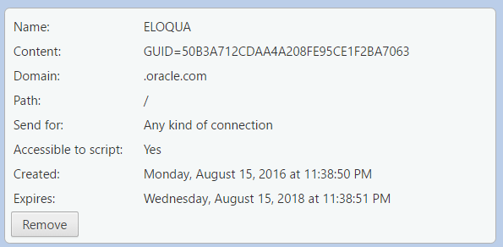
What is in the Cookie?
The cookie file contains a table with key-value pairs
5

Slide 17
Examine Your Cookies
Most cookies are stored in a RDBMS, usually SQLite
Download SQLite browser from here
Location of Mozilla cookies
Location of Chrome cookies
C:\Users\{username}\AppData\Roaming\Mozilla\Firefox\Profiles\{name}.default\cookies.sqlite
C:\Users\{username}\AppData\Local\Google\Chrome\User Data\Default\Cookies
5
Notes:
<number>

Slide 18
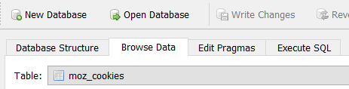
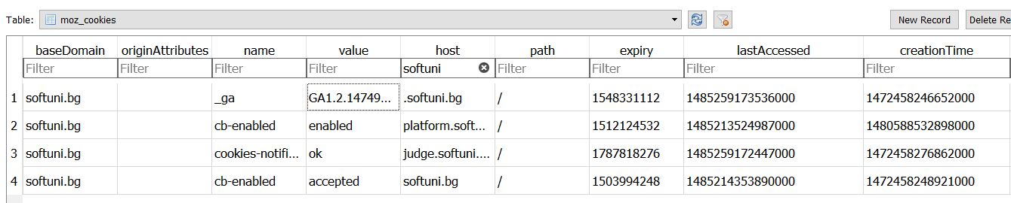
Examine Your Cookies (2)
Open the file with the SQLite browser
Browse the cookies table
Name
Host
Expiration date
Created on
Value
Paths
Last accessed on
5

Slide 19
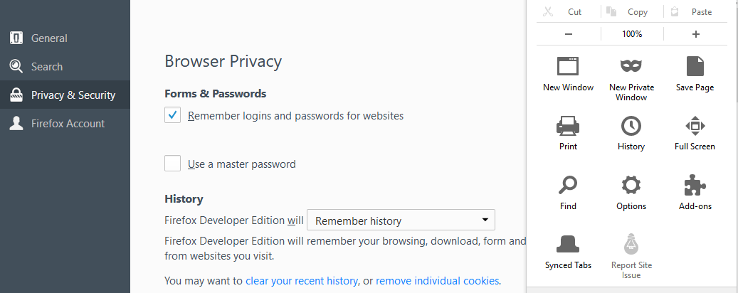
Control Your Cookies – Mozilla Browser
5

Slide 20
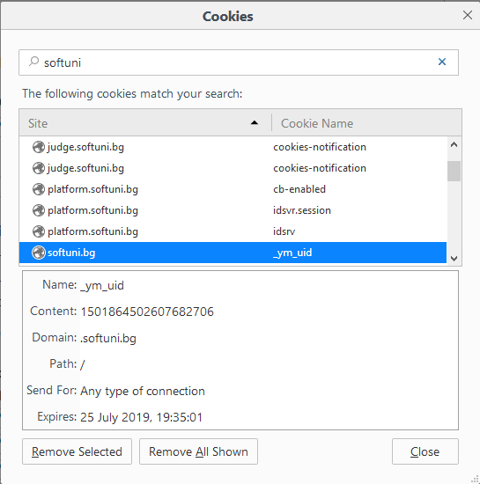
Control Your Cookies – Mozilla Browser (2)
Browse cookies from a selected website
Delete a particular cookie or all cookies
5

Slide 21
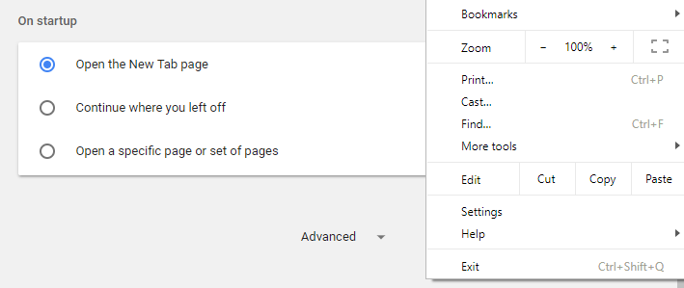
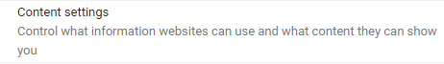
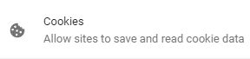
Control Your Cookies – Chrome Browser
5

Slide 22

Third Party Cookies
Cookies stored by an external party (different domain)
http://stackoverflow.com/
Web Application
Web Client
Cookie transfer
Cookie transfer
Third Party
5

Slide 23
Third Party Cookies
Cookies stored by an external party (different domain)
Mainly used for advertising and tracking across the web
http://stackoverflow.com/
Web Client
Web Application
Cookie transfer
Cookie transfer
Third Party
5

Slide 24

Cookies
Live Demo
5

Slide 25

HTTP Sessions

Slide 26


What are Sessions?
A way to store information about a user to be used across multiple pages
/login
Web Application
Session
/home
user: Teo
/products
5

Slide 27
Session Management
The exchange mechanism be used between the user and the web application
First Time Login
Web Client
Web Application
User credentials
Session ID
5
5

Slide 28
Session Management
The exchange mechanism be used between the user and the web application
Browsing Pages
Web Client
Web Application
Session ID
Requested data + Session ID
5
5

Slide 29
Session Management
The exchange mechanism be used between the user and the web application
Browsing pages after
the server is restarted
Web Client
Web Application
Session ID
Requested Data + Session ID
5
5

Slide 30
Relation with Cookies
Session Store
sid 5 { uid: 101 }
sid 7 { uid: 102 }
Cookie {
name: sid value: 5
}
Validate
Req
Web Application
Session
Resp
Database
Cookie {
name: sid value: 7
}
Req
Get data
uid name 101 Teo
102 Bojo
Resp
Create personal web page
5

Slide 31
Session Structure
"hje85d3" : {
user_id: 789
username: FirstUser
},
"af354dd" : {
user_id: 456
username: SecondUser
},
"fg78e5s" : {
user_id: 654
username: ThirdUser
}
Unique
Session ID
Key-Value pairs with user data
5

Slide 32
Sessions
Live Demo
5

Slide 33

Summary
…
…
…
Cookies are client based stored information
They are created by web applications
Browser sends them back to the application
Sessions are server based information
They are used across multiple pages
Stores important info about the client
33
Notes:
© Software University Foundation – http://softuni.org
This work is licensed under the Creative Commons Attribution-NonCommercial-ShareAlike license.
<number>

Slide 34
https://softuni.bg/trainings/courses
Notes:
© Software University Foundation – http://softuni.org
This work is licensed under the Creative Commons Attribution-NonCommercial-ShareAlike license.
<number>

Slide 35












SoftUni Diamond Partners

Slide 36




SoftUni Organizational Partners

Slide 37




Trainings @ Software University (SoftUni)
Software University – High-Quality Education and Employment Opportunities
softuni.bg
Software University Foundation
http://softuni.foundation/
Software University @ Facebook
facebook.com/SoftwareUniversity
Software University Forums
forum.softuni.bg
Notes:
© Software University Foundation – http://softuni.org
This work is licensed under the Creative Commons Attribution-NonCommercial-ShareAlike license.
<number>

Slide 38

License
This course (slides, examples, demos, videos, homework, etc.) is licensed under the "Creative Commons Attribution-NonCommercial-ShareAlike 4.0 International" license
38
Notes:
© Software University Foundation – http://softuni.org
This work is licensed under the Creative Commons Attribution-NonCommercial-ShareAlike license.
<number>

